Slide 1

OOP
Object Oriented Programming
Lecture 18
Lecture 1

Slide 2
Quick Recap of friend function and discussion of friend class

Slide 3
Friend Function
Step 1: What is a Friend?
In real life, a friend is someone who can access your personal information (like your phone number or your secrets), even though they’re not a part of your family.
Similarly, in C++, a friend function or friend class is something that can access the private or protected data of a class, even though it’s not a member of that class.

Slide 4
Friend Class
Step 2: What is a Class?
Imagine a class as a house. It has:
Private rooms (private data members): Only the owner (the class) can enter.
Common areas (public data members): Everyone can access these.
Now, what if you want to allow your best friend (a function or another class) to enter your private room? That’s where the friend keyword comes in.

Slide 5
Friend Function
Step 3: Friend Function
A friend function is like a trusted friend who can enter your private room without knocking.
Example
Let’s say we have a class Box that stores the length of a box. Normally, the length is private, but we want to create a separate function (not part of the class) to access and display the length.
Here’s how it looks in code:

Slide 6
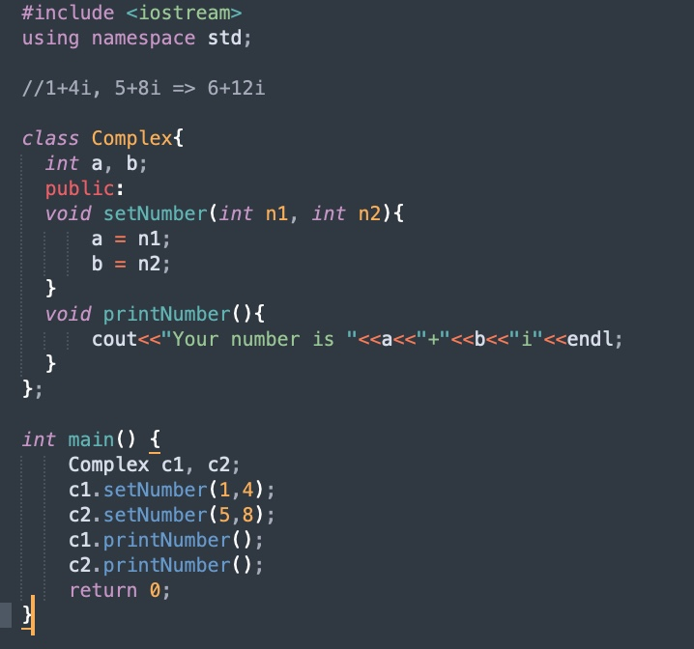
Friend Function in C++
Notes:
Task 1 contains the code of this

Slide 7
What is the output if i make the changes mentioned in the next slide?

Slide 8
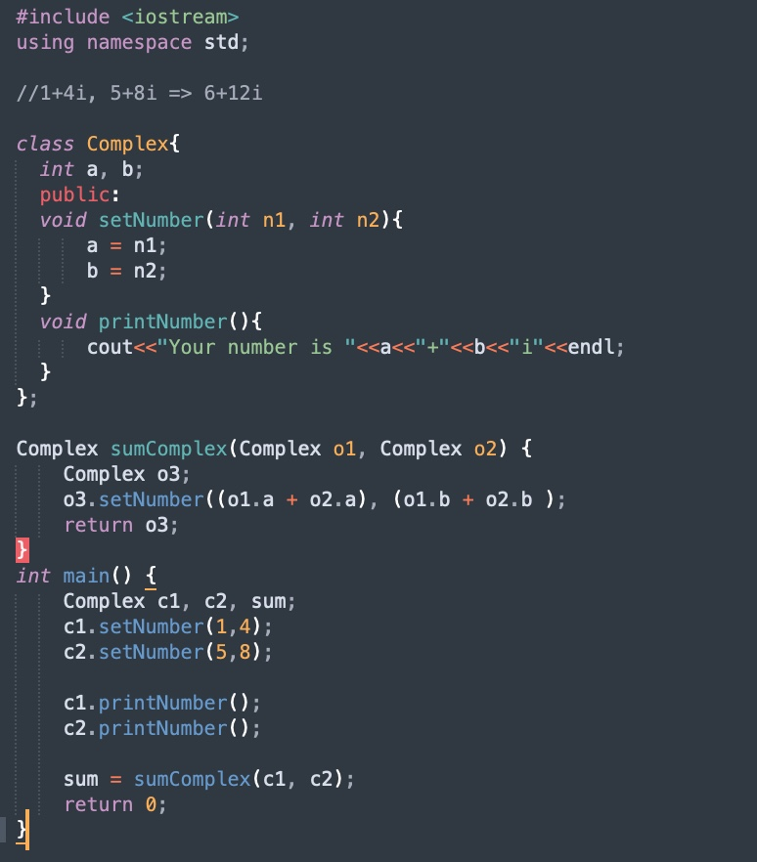

Slide 9
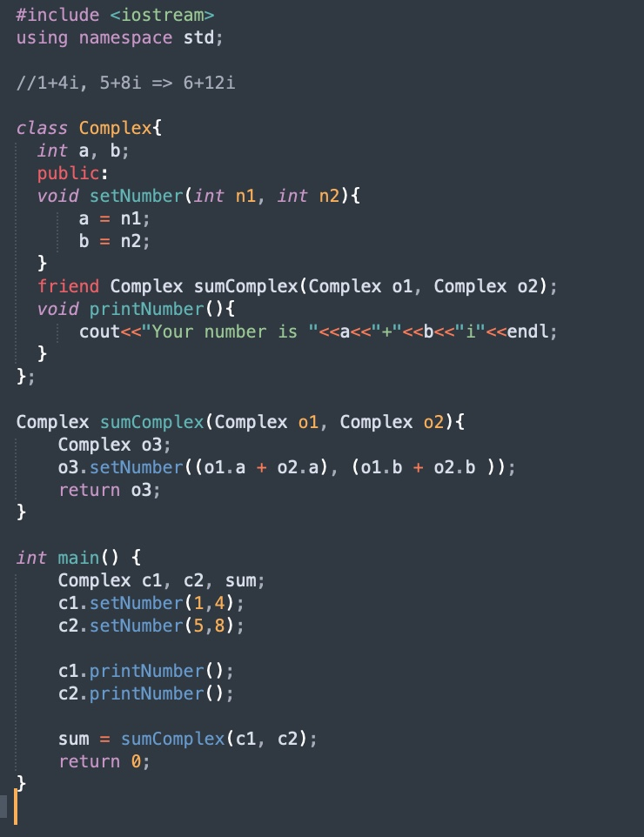
Solution

Slide 10
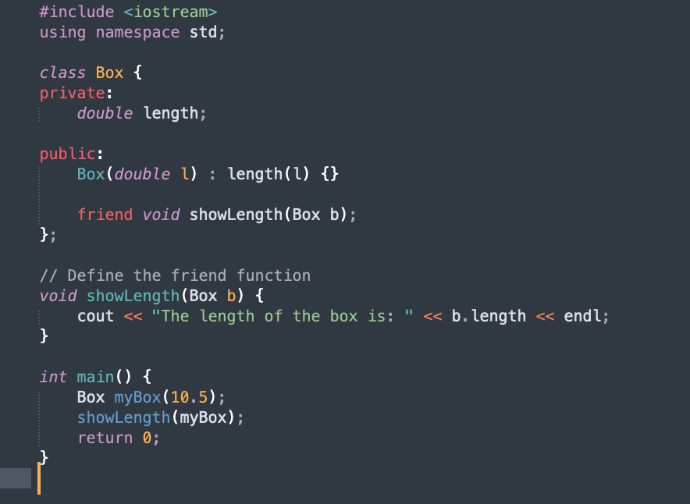
Friend Function - Example 2

Slide 11
Properties of Friend Function
Not in the scope of class
Since it is not in the scope of the class, it cannot be called from the object of that class, i.e., c1.sumComplex() == invalid
Can be invoked without the help of any object
Usually contains the arguments as the objects
Can be declared inside the private or public section of the class
It cannot access the members by their names

Slide 12
Friend Class
A friend class is a class that has access to the private and protected members of another class. In simpler terms, one class can give special permission to another class to access its private data.
Real-Life Analogy:
Student is a class that stores details about a student, such as their grades.
Teacher is another class that can access the private grades of a student to check how well they are doing.
Normally, a teacher (class) wouldn’t be able to access a student’s private grades (data), but by making the teacher a friend class of the student, we give the teacher special permission to access that data.

Slide 13
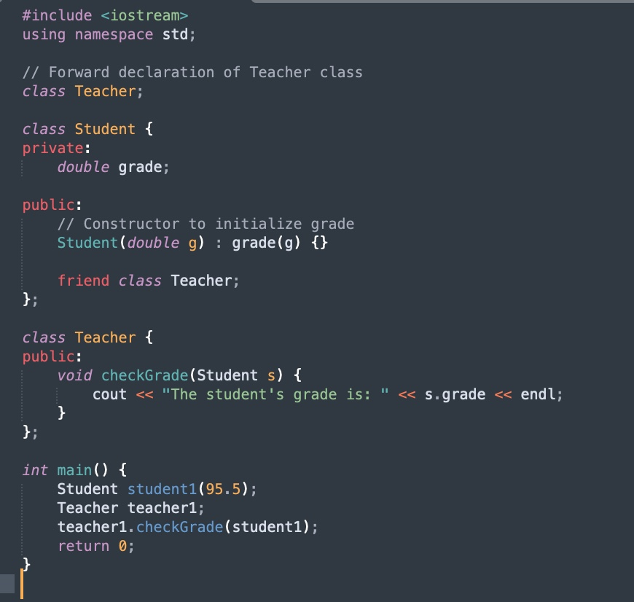
Friend Class - Example

Slide 14
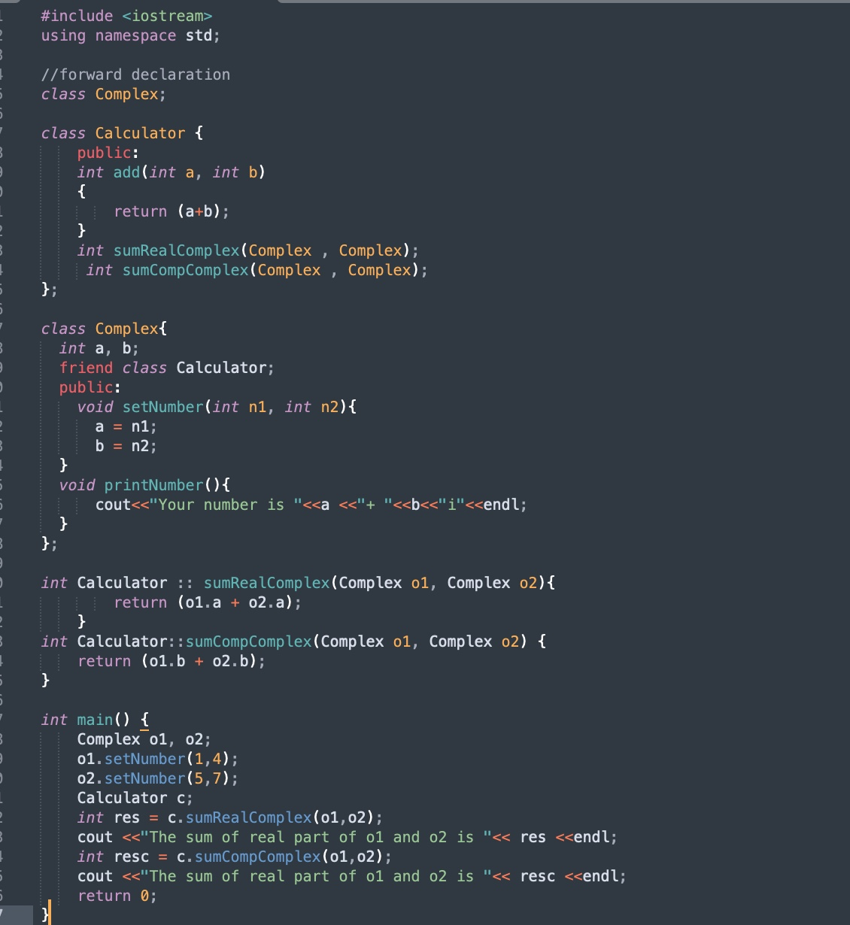
Friend Class - Complex Example

Slide 15
Difference Between Friend Function and Friend Class
Both friend function and friend class allow external functions or classes to access private and protected members of another class. However, there are key differences between the two.
Let’s break it down step by step:
1. Definition
Friend Function: A friend function is a specific function that is given permission to access the private and protected members of a class, even though it is not a member of that class. It could be a standalone function or a member function of another class.
Friend Class: A friend class is a whole class that is given permission to access the private and protected members of another class. All member functions of the friend class can access the private data of the other class.

Slide 16
Difference Between Friend Function and Friend Class
2. Scope of Access
Friend Function: Only the specific function that is declared as a friend can access the private members of the class. It doesn't have access to the entire class; only the function is given special access.
Friend Class: All member functions of the entire friend class are granted access to the private and protected members of the other class. This means every function in the friend class can access the private data.

Slide 17
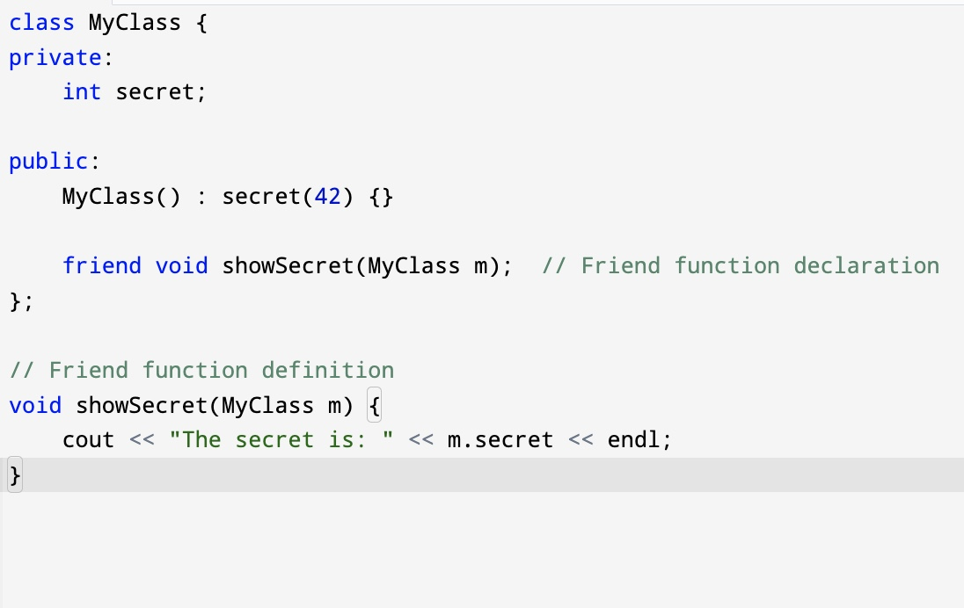
Difference Between Friend Function and Friend Class
3. Declaration
Friend Function: A friend function is declared inside the class using the friend keyword. You specify a single function (or method) to be given special access.

Slide 18
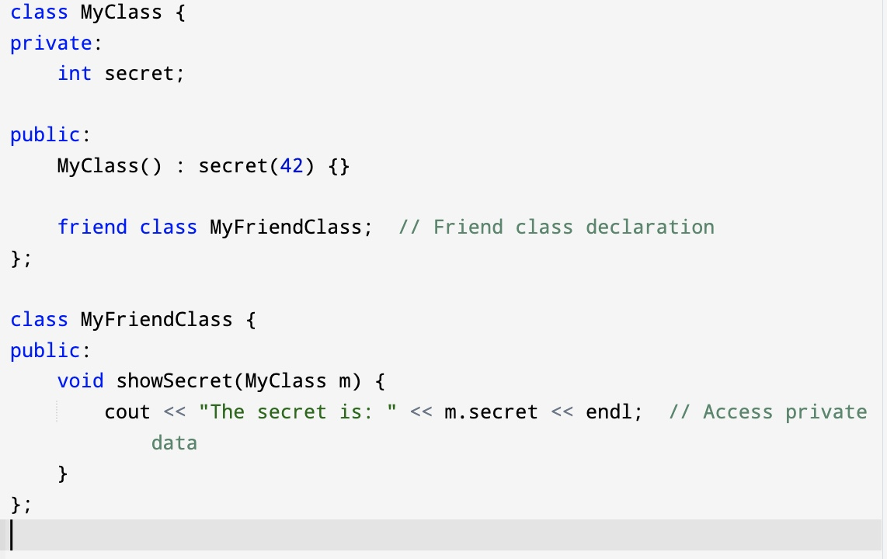
Difference Between Friend Function and Friend Class
3. Declaration
Friend Class: A friend class is declared inside the class using the friend keyword. The entire class is given special access to the private members.

Slide 19
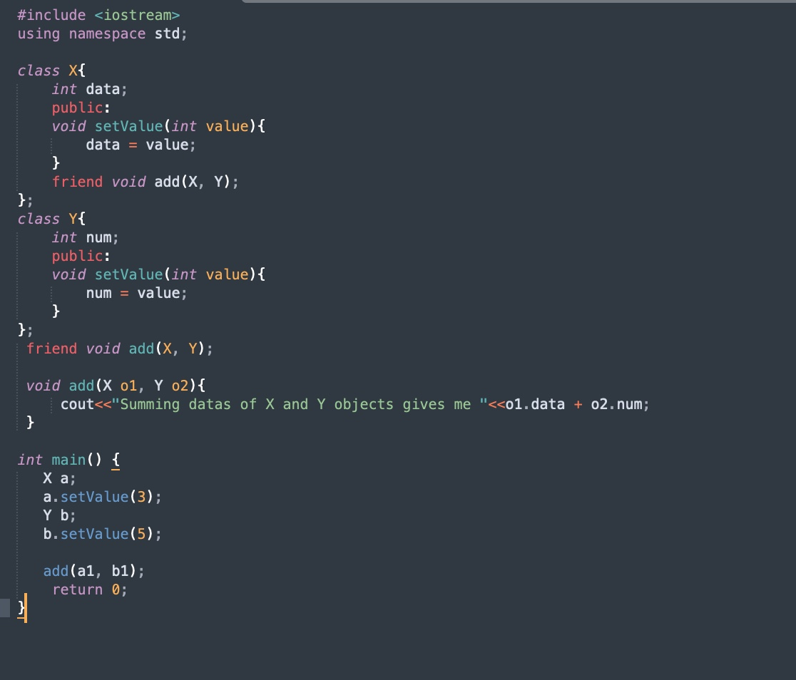
More Examples - Output of this code?

Slide 20
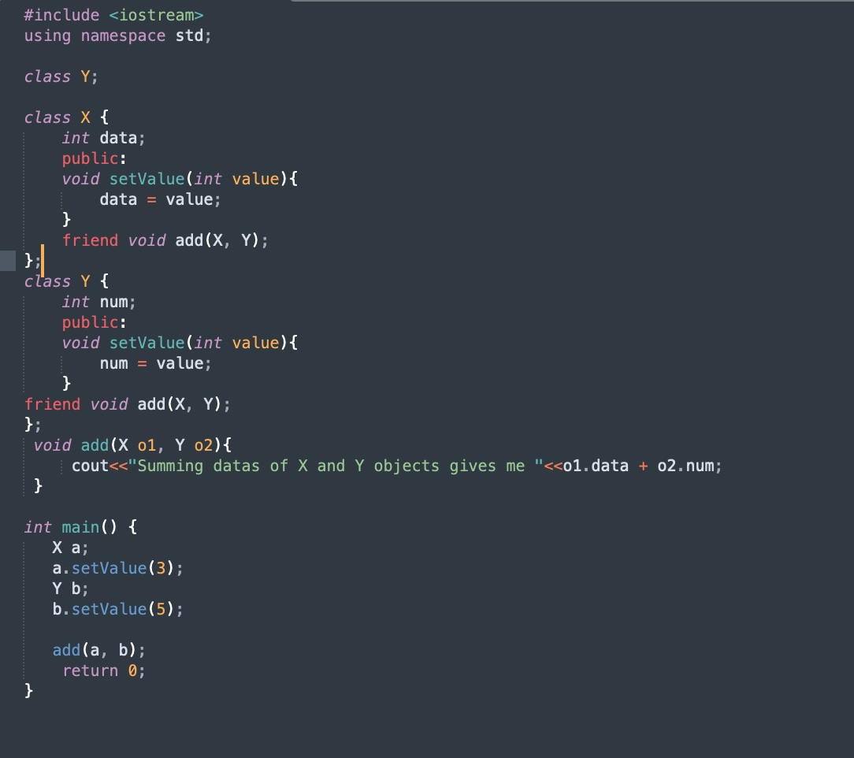
Correction

Slide 21
End of Lecture

